Slide 1
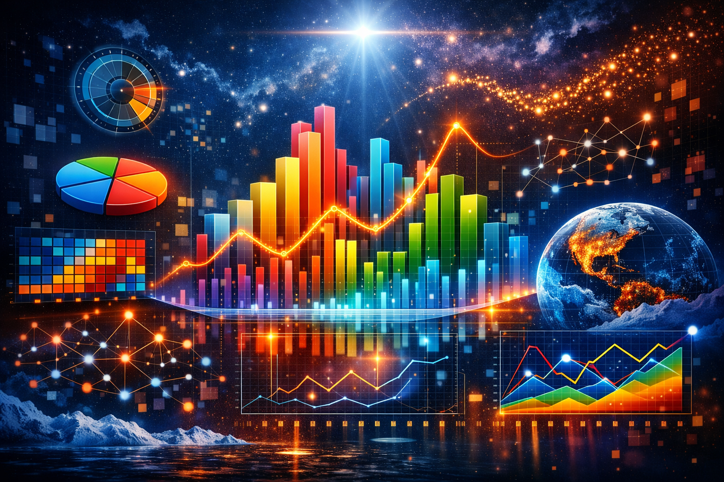
DATA VISUALIZATION
Dr Ashok Gopalakrishnan
Retired Scientist from NASA, Google Scholar, Alumni of IIT Bombay
Oxford University & Georgia Tech, USA

Slide 2
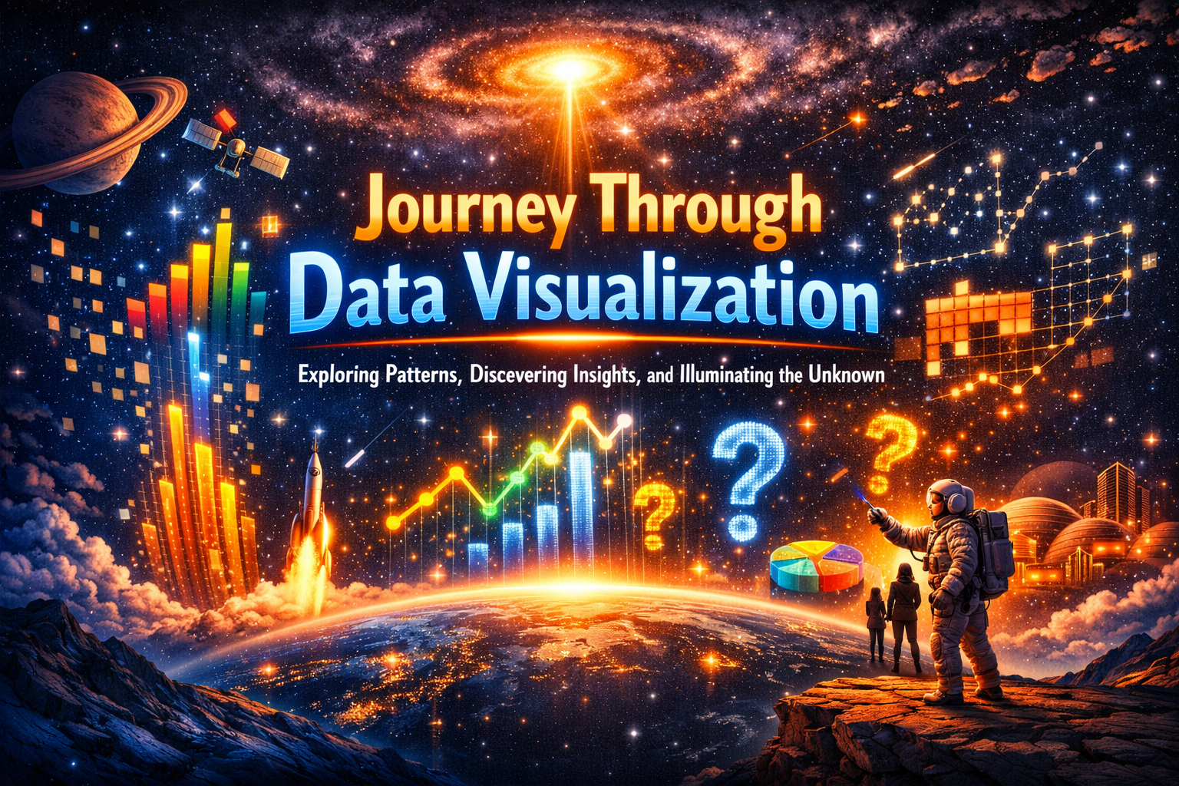

Slide 3
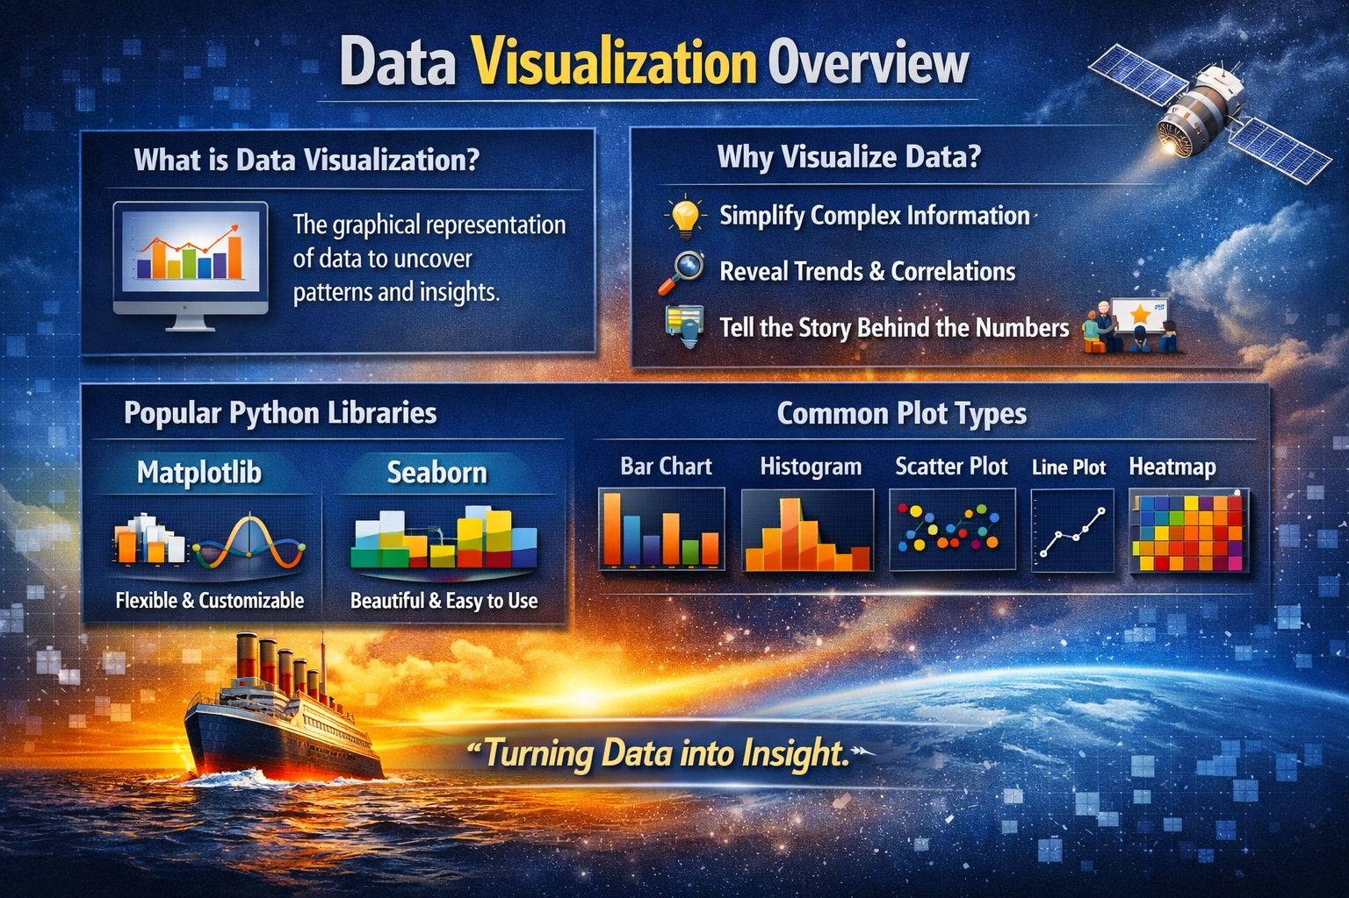
DATA VISUALIZATION

Slide 4
DATA VISUALIZATION
Data Visualization
Definition: The process of representing data graphically to reveal patterns, trends, and insights that raw numbers alone cannot show.
Purpose:
Simplifies complex datasets.
Helps communicate findings clearly.
Supports decision‑making and storytelling.
Examples in STEM:
Plotting solar flare intensity vs. time.
Showing spacecraft telemetry trends.
Visualizing Titanic survival rates by gender/class.

Slide 5
DATA VISUALIZATION
Matplotlib
Overview: The foundational Python library for creating static, interactive, and animated plots.
Strengths: Fine‑grained control over every element (axes, labels, colors).
Example:
python
import matplotlib.pyplot as plt
ages = [22, 35, 58, 42, 29]
fares = [7.25, 71.83, 8.05, 27.72, 21.07]
plt.scatter(ages, fares)
plt.xlabel("Age")
plt.ylabel("Fare")
plt.title("Age vs Fare (Titanic)")
plt.show()

Slide 6
DATA VISUALIZATION
Seaborn
Overview: Built on Matplotlib, but higher‑level and aesthetically pleasing.
Strengths: Simplifies statistical plots, integrates well with Pandas DataFrames.
Example:
python
import seaborn as sns
import pandas as pd
df = pd.DataFrame({"Age":[22,35,58,42,29],
"Fare":[7.25,71.83,8.05,27.72,21.07],
"Survived":[0,1,0,1,1]})
sns.scatterplot(x="Age", y="Fare", hue="Survived", data=df)

Slide 7
DATA VISUALIZATION
Common Graphs & Plots
Plot Type | Purpose | Example
Bar Chart | Compare categories | Survival counts by gender
Histogram | Show distribution | Age distribution of passengers
Scatter Plot | Show relationships | Age vs. Fare, color‑coded by survival
Line Plot | Show trends over time | Solar flux intensity vs. time
Heatmap | Show correlations | Titanic features correlation matrix
“When we visualize data, we don’t just see numbers — we see meaning, motion, and discovery.”

Slide 8
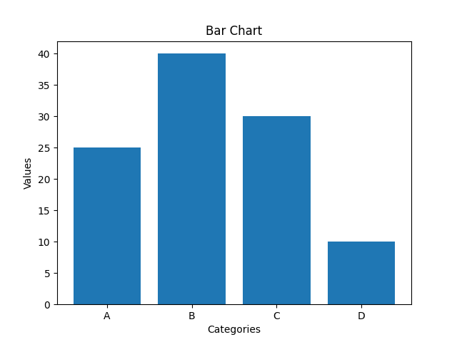
DATA VISUALIZATION
Types of Data Visualization Charts:
From Basic to Advanced
Basic Charts for Data Visualization
Basic charts are best suited for displaying simple comparisons, trends over time and basic relationships within the data. These charts are easy to understand and ideal for communicating insights to a broad audience.
1. Bar Charts
Bar charts are used to compare values across different categories using rectangular bars. X-axis shows categories while Y-axis represents values. Common types include horizontal, stacked and grouped bar charts.
When to Use:
To compare different categories
To rank values from highest to lowest
To show relationships between multiple variables

Slide 9
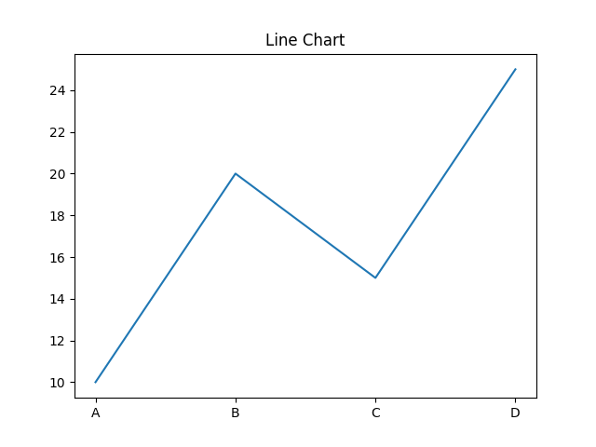
DATA VISUALIZATION
Types of Data Visualization Charts
From Basic to Advanced
2. Line Charts
Line charts show how values change over time by connecting data points with lines. They help visualize trends like increases, decreases or stability.
When to Use
To track changes over time
To compare trends across multiple data series
For time series analysis

Slide 10
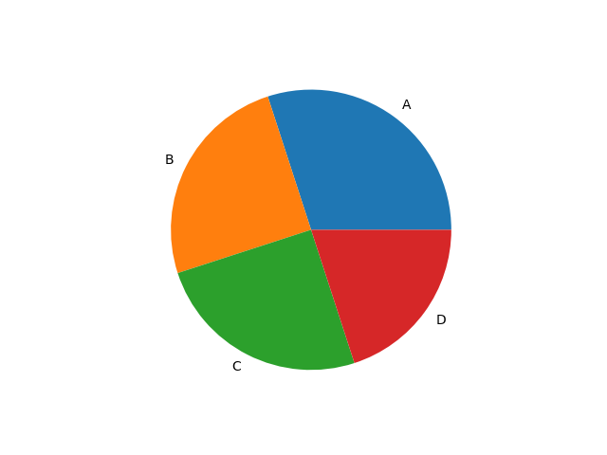
DATA VISUALIZATION
3. Pie Charts
Pie charts are round charts divided into slices, where each slice shows a part of the whole. The size of each slice represents its percentage.
When to Use:
To show how different parts contribute to a whole
To highlight a dominant category

Slide 11
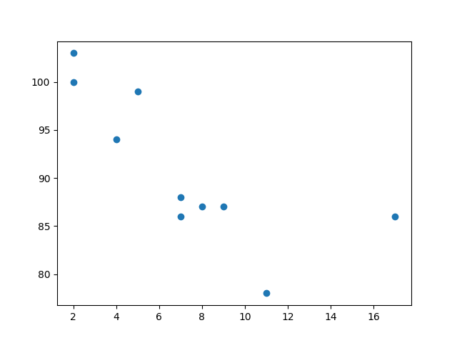
DATA VISUALIZATION
4. Scatter Chart (Plots)
Scatter charts use dots to show relationship between two numerical variables. X-axis shows the independent variable and Y-axis shows the dependent variable.
When to Use:
To observe relationships between two variables
To detect patterns, clusters or outliers in data

Slide 12
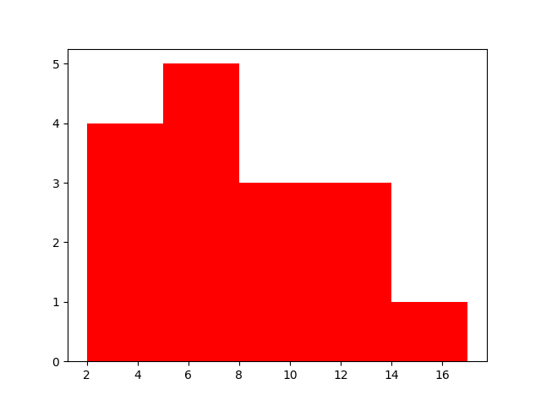
DATA VISUALIZATION
5. ﻿Histogram
A histogram displays the distribution of numerical data by grouping values into intervals (bins) and showing their frequency as bars. It helps reveal the shape, spread and patterns in the data.
When to Use:
To visualize the distribution of numerical data
To explore patterns, trends and outliers

Slide 13
DATA VISUALIZATION
Titanic Data Science Project — Complete Guide
Where to Get the Data
Primary Source: The Titanic dataset is publicly available on Kaggle under “Titanic: Machine Learning from Disaster.”
It contains training and test CSV files.
You can download it free after creating a Kaggle account.
File names: train.csv, test.csv, and gender_submission.csv.
Alternate Sources:
seaborn.load_dataset("titanic") — built‑in dataset for quick exploration.
GitHub repositories and open‑data portals often mirror the same dataset.

Slide 14
DATA VISUALIZATION
Titanic Data Science Project — Complete Guide
Type of Data
Category | Example Columns | Description
Demographic | PassengerId, Name, Sex, Age | Basic passenger details
Socio‑economic | Pclass, Fare, Cabin, Embarked | Ticket class, fare, and port of embarkation
Family | SibSp, Parch | Number of siblings/spouses and parents/children aboard
Outcome | Survived | Target variable (1 = Survived, 0 = Did not survive)

Slide 15
DATA VISUALIZATION
Titanic Data Science Project — Complete Guide
How to Apply the Data
Step‑by‑Step Workflow:
Import Libraries pandas, numpy, matplotlib, seaborn, sklearn.
Load Data
python
import pandas as pd
df = pd.read_csv("train.csv")
Explore
df.info() and df.describe() for structure.
Visualize survival by gender/class using Seaborn.

Slide 16
DATA VISUALIZATION
Titanic Data Science Project — Complete Guide
Clean
Handle missing values (Age, Cabin, Embarked).
Convert categorical data to numeric (e.g., Sex, Embarked).
Model
Split into training/testing sets.
Apply Logistic Regression, Decision Tree, or Random Forest.
Predict & Evaluate:
Measure accuracy, precision, recall.
Visualize confusion matrix and ROC curve.
Communicate Insights:
Females and first‑class passengers had higher survival rates.
Fare and age influenced outcomes.

Slide 17
DATA VISUALIZATION
Titanic Data Science Project — Complete Guide
Teaching Notes for the Workflow
Seven Steps in the Titanic Project
Get the Data (📂) — Download from Kaggle (train.csv, test.csv) or use Seaborn’s built‑in Titanic dataset.
Explore (🔍) — Use Pandas, Matplotlib, Seaborn to understand distributions and relationships.
Clean (🧹) — Handle missing values (Age, Cabin, Embarked), encode categorical variables.
Model (🤖) — Train algorithms like Logistic Regression, Decision Trees, or Random Forest.
Predict (📈) — Generate survival predictions for test data.
Evaluate (📊) — Measure accuracy, precision, recall; visualize confusion matrix and ROC curve.
Communicate (💬) — Share insights: survival patterns by gender, class, age, and fare.

Slide 18
Titanic Data Science Project — Student Worksheet
Step‑by‑Step Workflow
Get the Data (📂)
Load train.csv from Kaggle or Seaborn dataset.
Task: Count survivors vs. non‑survivors.
Explore (🔍)
Use Pandas + Seaborn for quick plots.
Task: Plot survival by gender and class.
Clean (🧹)
Fill missing values (Age, Embarked).
Encode categorical variables (Sex, Embarked).
Task: Check for remaining nulls.
Model (🤖)
Train Logistic Regression or Decision Tree.
Task: Interpret coefficients — which features matter most?
Predict (📈)
Generate survival predictions.
Task: Compare predicted vs. actual for 10 passengers.
Evaluate (📊)
Accuracy, confusion matrix, ROC curve.
Task: Discuss what the confusion matrix shows.
Communicate (💬)
Visualize insights (e.g., gender vs. survival).
Task: Write a short summary of findings.

Slide 19
DATA VISUALIZATION
Python Basics — Syntax & Core Concepts
1️⃣ Syntax Essentials
Indentation: Python uses indentation (spaces) instead of braces {} to define code blocks.
python
if True:
print("Hello, World!")
Case Sensitivity: Variable names are case‑sensitive (Name ≠ name).
Comments:
Single‑line → # This is a comment
Multi‑line → triple quotes
python
"""
This is a multi-line comment
"""

Slide 20
DATA VISUALIZATION
2️⃣ Variables & Data Types
Type | Example | Description
int | x = 10 | Integer numbers
float | pi = 3.14 | Decimal numbers
str | name = "Ashok" | Text strings
bool | flag = True | Logical values
list | nums = [1,2,3] | Ordered, mutable collection
tuple | coords = (10,20) | Ordered, immutable collection
dict | student = {"name":"Nova","age":10} | Key‑value pairs

Slide 21
DATA VISUALIZATION
3️⃣ Control Structures
Conditional Statements:
python
if age > 18:
print("Adult")
elif age == 18:
print("Just adult")
else:
print("Minor")
Loops:
python
for i in range(5):
print(i)
python
while condition:
# repeat until condition is False

Slide 22
DATA VISUALIZATION
3️⃣ Control Structures
Conditional Statements:
python
if age > 18:
print("Adult")
elif age == 18:
print("Just adult")
else:
print("Minor")
Loops:
python
for i in range(5):
print(i)
python
while condition:
# repeat until condition is False

Slide 23
DATA VISUALIZATION
4️⃣ Functions
Reusable blocks of code:
python
def greet(name):
return f"Hello, {name}!"
print(greet("Ashok"))
5️⃣ Libraries & Modules
Import built‑in or external libraries:
python
import math
print(math.sqrt(16))

Slide 24
DATA VISUALIZATION
7️⃣ Error Handling
python
try:
x = 10 / 0
except ZeroDivisionError:
print("Cannot divide by zero!")
8️⃣ File Handling
python
with open("data.txt", "r") as file:
content = file.read()
print(content)

Slide 25
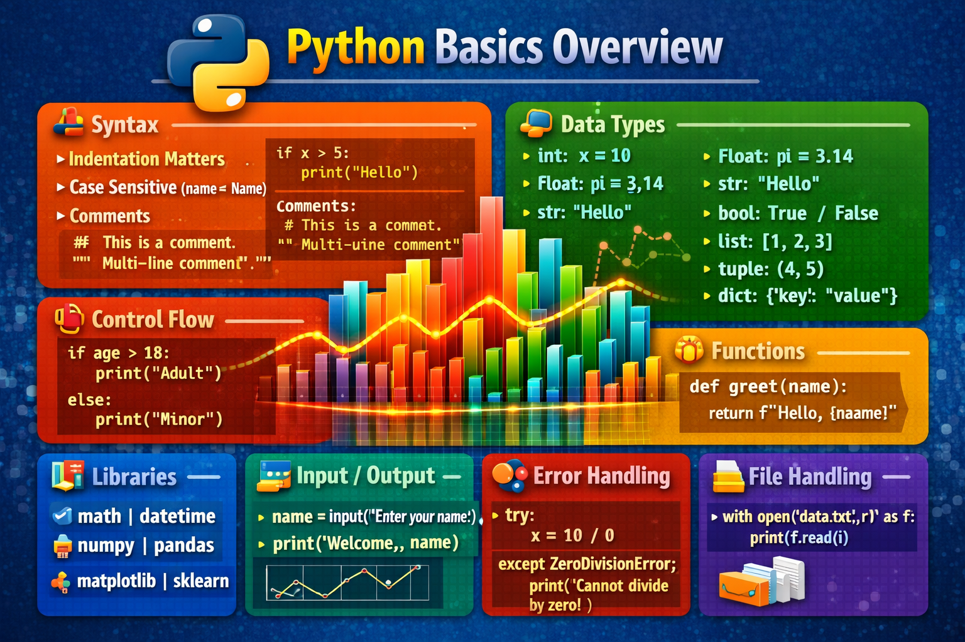
DATA VISUALIZATION

Slide 26
DATA VISUALIZATION
Python Basics — Practice Exercises 1 ( To be given on 19 June for submission on 20 June by 5 pm) ti IICT
Python Basics — Practice Exercises 2 ( To be given on 20 June for submission on 22 June by 5 pm) ti IICT
Python Basics — Practice Exercises 3( To be given on 22 June for submission on 24 June by 5 pm) ti IICT
Python Basics — Practice Exercises 4 ( To be given on 24 June for submission on 26 June by 5 pm) ti IICT

Slide 27
DATA VISUALIZATION
Levels of Data Visualization
1. Basic Visuals
Bar Charts: Compare categories (e.g., Titanic survival by gender).
Line Charts: Show trends over time (e.g., spacecraft telemetry).
Histograms: Display distributions (e.g., passenger ages).
Scatter Plots: Reveal relationships (e.g., age vs. fare).
2. Intermediate Visuals
Heatmaps: Show correlations or intensity (e.g., feature correlation matrix).
Boxplots: Summarize distributions with medians and outliers.
Treemaps/Sunbursts: Hierarchical data visualization.
Sankey Diagrams: Flow between stages (energy, migration, or resource usage).
3. Advanced Visuals
Interactive Dashboards: Built with Tableau, Power BI, Plotly Dash.
Geospatial Maps: Visualize data on maps (e.g., COVID spread, satellite imagery).
Network Graphs: Show relationships between nodes (e.g., social networks, citation graphs).
3D Visualizations: Useful for scientific data (astronomy, molecular structures).
🎨 Design Principles
Color: Use meaningfully (red = risk, green = growth).
Scale: Always start axes at zero unless justified.
Clarity: Avoid chart junk — “less ink, more insight.”
Accessibility: Ensure readability for color‑blind audiences (use palettes like ColorBrewer).

Slide 28
DATA VISUALIZATION
Cognitive Aspects
Humans process patterns faster than numbers.
Shapes, colors, and positions guide attention.
Storytelling matters: visuals should answer “What’s the key insight?”
🛠️ Tools & Libraries
Python: matplotlib, seaborn, plotly, bokeh.
R: ggplot2, shiny.
Business: Tableau, Power BI.
Web: D3.js, Google Charts.
I am going to give you all the datasets (Titanic) and will ask the following questions for your project :
Which chart type best answers the question?
How does design choice affect interpretation?
Can you make the visualization more engaging without losing clarity?
You need to answer without taking help. Marks will be deducted if you take help from ChatGPT etc

Slide 29
DATA VISUALIZATION
Data visualization is not just about creating attractive charts — it is about transforming raw data into meaningful insights. By applying the right techniques, we can simplify complexity, highlight patterns, and make information accessible to diverse audiences. In today’s world of overwhelming data, visualization becomes the bridge between numbers and understanding.
We explored how different visualization methods — from basic bar charts and scatter plots to advanced heatmaps and interactive dashboards — each serve a unique purpose. The choice of chart type is not arbitrary; it depends on the question we want to answer and the story we want to tell. Good visualization is therefore both a technical skill and a design discipline, requiring clarity, accuracy, and creativity.
Ultimately, the power of data visualization lies in its ability to inspire action. Whether we are analyzing survival patterns in the Titanic dataset, monitoring solar flare intensity, or presenting business insights, the goal remains the same: to communicate knowledge effectively. When we visualize data, we don’t just see numbers — we see meaning, motion, and discovery.

Slide 30
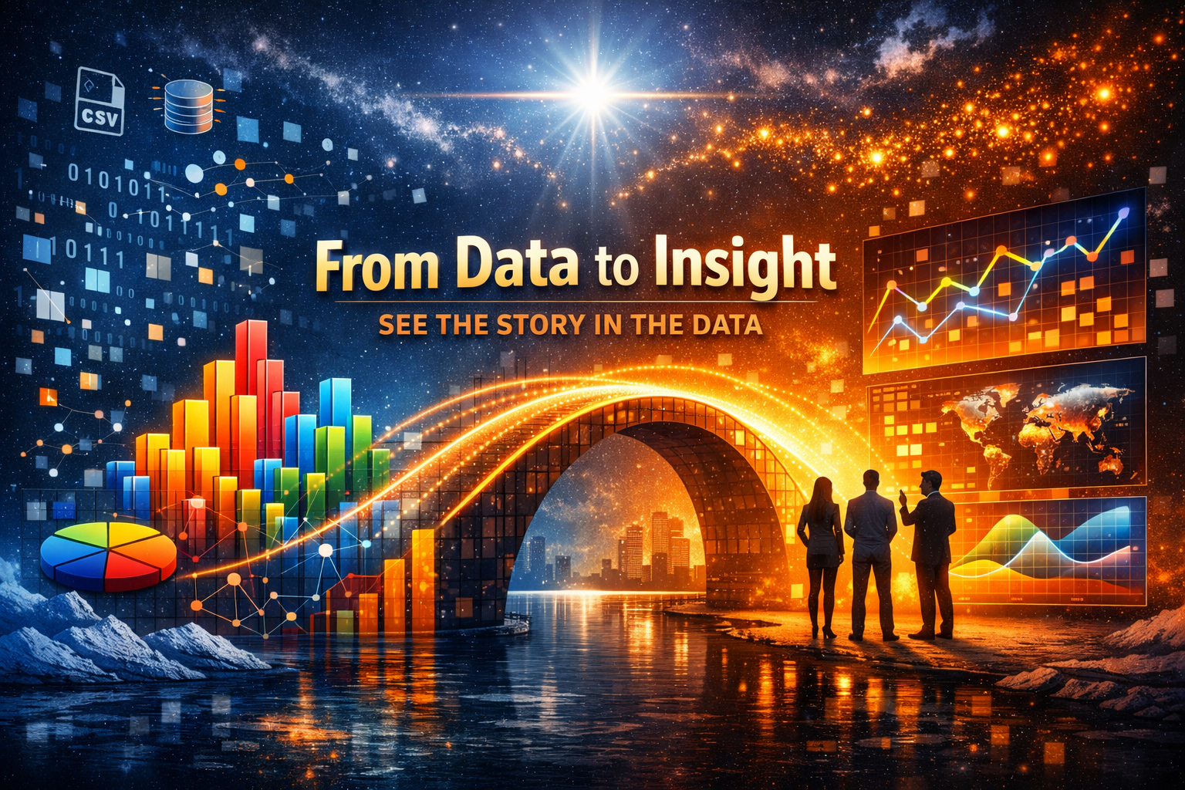
DATA VISUALIZATION
“From data to insight, visualization is the bridge that turns numbers into stories.”

Slide 31
DATA VISUALIZATION
Interactive Q&A Prompt
Question 1: If you had to visualize the Titanic dataset, which chart would best show survival by gender and class — and why? 🧩 (Encourages you all to connect chart choice with storytelling.)
Question 2: How can poor design choices — like misleading scales or excessive color — distort the message of a visualization? 🧠 (Promotes critical thinking about ethics and clarity in data communication.)

Slide 32

“We’ve journeyed through the universe of data — now it’s your turn to ask, explore, and ignite new insights.”

